Slide 1
Embedded Systems Development: some additional tools
Review--Requirements:
  Functionality
  Dependability
  Efficiency
  Real-time Constraints
  Combine hw/sw
  Security
  Safety
  Work in specific environment

Slide 2
Capability Maturity Model
CMM : capability maturity model--defines level of the development process itself
1. Initial: ad hoc
2. Repeatable: basic project management processes in place
3. Defined: documented process integrated into an organization-wide software process
4. Managed: detailed measures are collected
Optimizing--desired level: Continuous process improvement from quantitative feedback

Slide 3
Typical design flow
Example: V-model
Requirement
analysis
System
architecture
System
design
Software
architecture
At each stage: develop tests / apply tests
Software
design
Unit
tests
Integration
testing
System
integration
Acceptance
& use
Skipping some explicit repository updates;
very late integration, problems may be missed ..

Slide 4
Development and Testing Stages
levels of test development stage
white or glass box code / “gates”
black box class / component
integration connection diagram (schematic)
system use case (“specification”)
A simple test strategy:
----develop test with design at each stage
----during implementation, all tests must be passed (100%)
----if modifications are made, all tests must be rerun
----if errors are found, new tests must be written to cover them (“regression testing”)
----complete test suite, updated during development, must be maintained; when new errors are identified, fix them and update test suite

Slide 5
OO: class concept supports encapsulation, information hiding
“objects” or “modules” can also model hardware components
OO Prog.
DATA
DATA
DATA
DATA
DATA
DATA
DATA
Procedural Prog.

Slide 6
Our tools:
“repeatable” process, collect some measures
“annotated” UML
  already discussed
  to be discussed
use cases
  object diagrams /annotated object diagrams
sequence diagrams
  annotated sequence diagrams
fsms
state charts
activity diagrams
Implementation—verilog / c—”coding standards”
Testing—DFT, “contracts”
Some discussion of formal methods

Slide 7
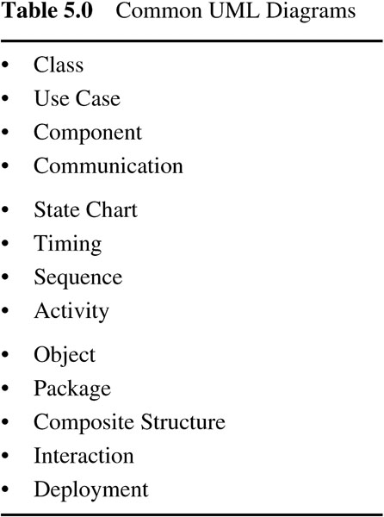


table_05_00
Note that “UML” syntax can vary among implementations
Note that UML has many tools that can be used
table_05_00

Slide 8
Review: Using UML in a project: design; design for testability
Design: “top-down”; Test: “bottom-up” : “Design for testability”
determine specifications:
use cases system tests
determine classes [modules] and connections (static behavior):
ER or class diagrams; CRC cards module (“black box”) tests
model dynamic behavior:
interaction (object message) diagrams
activity diagrams
state diagrams (fsm’s)
sequence diagrams
[ individual class methods “white box” or “glass box” tests]

Slide 9
Additional important concepts in embedded systems:
--concurrency: the system can handle multiple active independent or cooperating objects at the same time
--thread [of control]—models sequential execution of a set of instructions; embedded system may have several concurrent threads operating simultaneously
--persistence—how long does a software object last?
Examples:
Temporary variable
Global variable
Software module

Slide 10
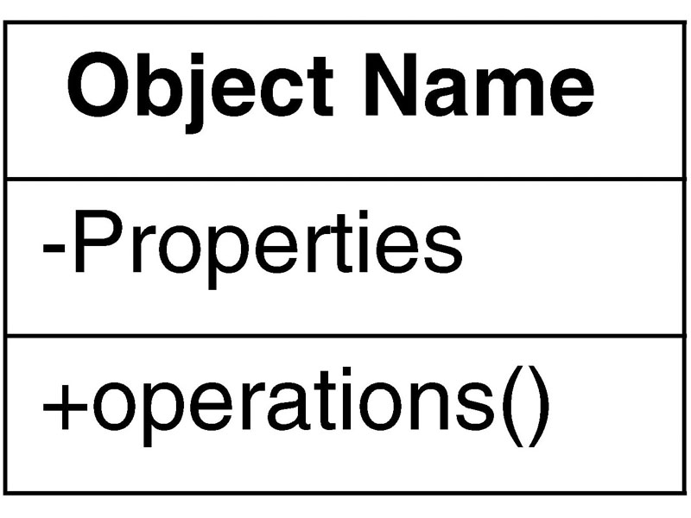
fig_05_03
UML: Class diagram (“CRC card”)
“Class name”
“objects”
“methods”
(responsibilities
and
collaborators)
(+ collaborators)

Slide 11
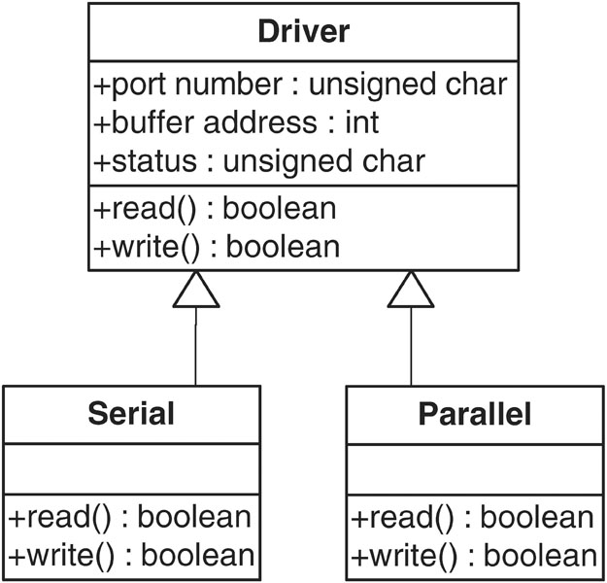
fig_05_04
UML: “class relationships: inheritance”

Slide 12
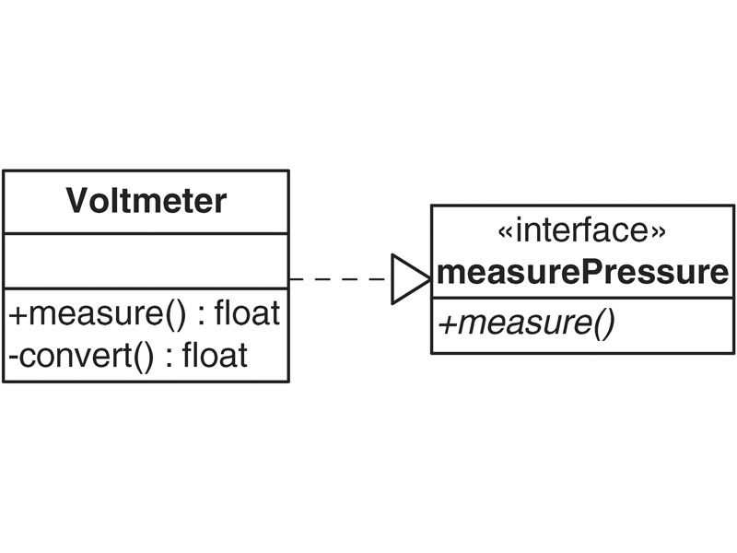
fig_05_05
UML: “interface”—similar to inheritance but different
public appearance
Hidden operation

Slide 13
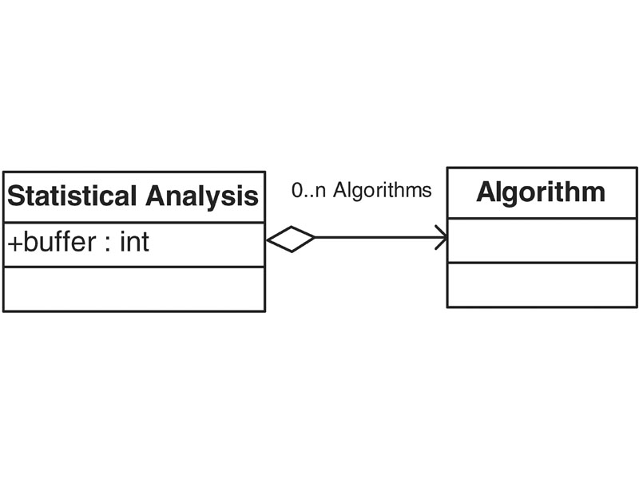
fig_05_06
UML: containment of one class within another (“has-a”)
Type 1: aggregation—statistical analysis has a number of algorithm “parts”

Slide 14
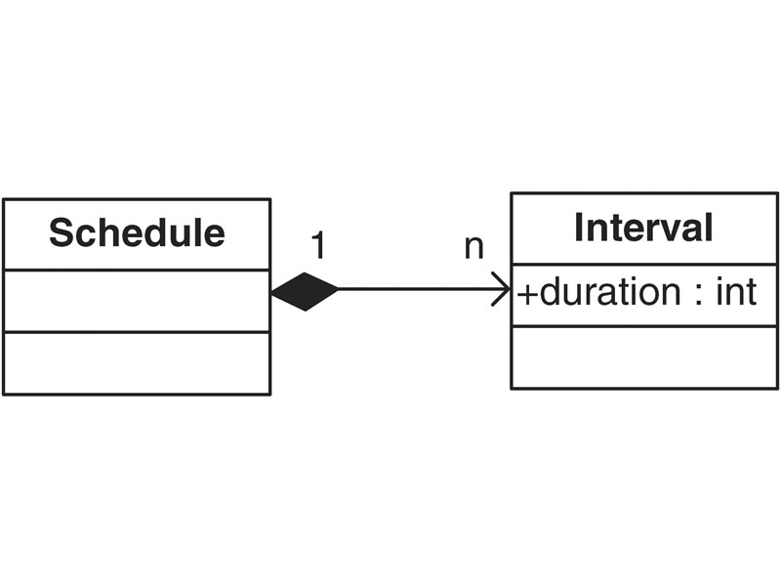
fig_05_07
UML: containment of one class within another (“has-a”)
Type 2: composition—here the intervals are meaningless outside the schedule (~ “local variables”)

Slide 15
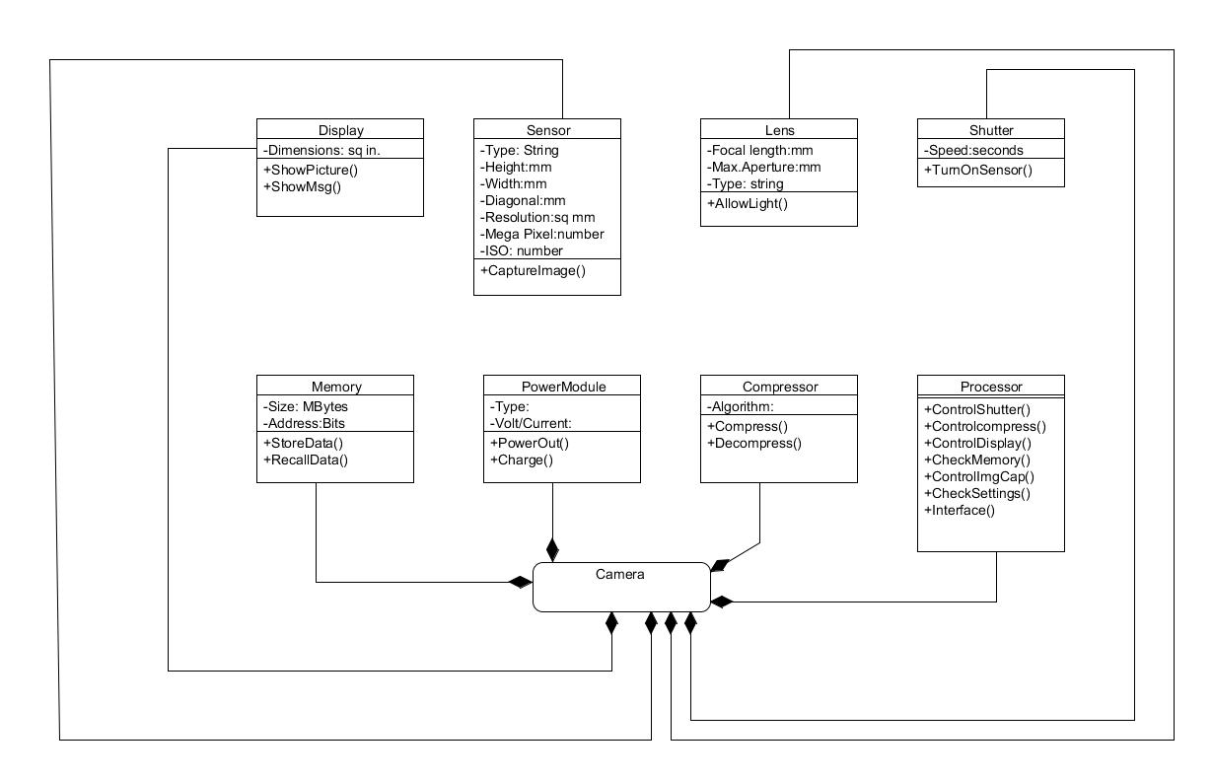
Camera example – Class diagram
(example from Vahid et al.)
Key:
HW:
HW/SW:

Slide 16
Preconditions, postconditions, invariants
“contracts”: between components (hw OR sw)
include preconditions, postconditions, and invariants (loop or class, e.g.).
Example: how do you ensure
--there is no division by zero?
--array bounds are not exceeded?
--I/O error does not cause system crash?
--faulty / missing component does not cause system crash?
Also important in formal methods specifications

Slide 17
Preconditions, postconditions, invariants--definitions
precondition: condition that a calling module guarantees before making the call
postcondition: condition that a called module guarantees upon completion
invariant: condition that is preserved by transformations
example: “loop” invariant is preserved by the transformations that occur with a repeated operation

Slide 18
Examples—preconditions, postconditions
--Send A,B to divider to compute A / B
precondition: make sure B is not 0
--Compress a picture in a digital camera
precondition: camera has completed any image enhancement
--Vending machine button pressed
precondition: sufficient funds entered
postcondition: product released
--Elevator respond to command to move to another floor
precondition: door is closed
postcondition: car stops when floor reached, door opens

Slide 19
[Loop] invariant
examples:
--in automobile factory, machine puts front doors on car
invariant: after each car processed, machine resets to initial position
-- similarly, a machine to paint a specific car part makes sure there is enough paint and nozzles are correctly positioned and not clogged, ready for next car
--watchdog timer is reset after successful completion of an operation

Slide 20
Other invariants
example: class invariant is preserved by all class operations
e.g., the size of an array is always >= 0
interface invariants: for public sections (users)
implementation invariants: for class implementations (designers, coders)

Slide 21
Software tool for expressing constraints:
Can use natural language or a special language such as OCL (Object Constraint Language)
Constraint is a boolean expression, returns value true or false
Constraint can be:
--attached to an entry in the CRC card if desired--may lead to cluttered documents
--specified by keyword context

Slide 22
Examples from text (this form or syntax in figure 9-5, page 360 should be used in object comments in project):
context Tournament inv:
self.getMaxNumPlayers( ) > 0
context Tournament::acceptPlayer(p:Player) pre:
!is PlayerAccepted(p)
context Tournament::acceptPlayer(p:Player) pre:
getNumPlayers( ) < getmaxNumPlayers( )
context Tournament::acceptPlayer(p:Player) post:
isPlayerAccepted(p)
This idea can also be extended to hardware modules

Slide 23
UML—dynamic modeling
Fsms + extensions
State diagrams (variants discussed earlier)
Additional methods

Slide 24
State Diagram--Example
Example: this state diagram example for an "order" in an order-processing system is from Fowler and Scott, UML Distilled (Addison-Wesley, 1997):
start
/get first item
[not all items checked]
/get next item
[all items
checked &&
all items available]
Dispatching
Checking
initiate delivery
check item
[all items
checked &&
some items not in
stock]
delivered
item received
[all items in stock]
Waiting
Delivered
item received
[some items not in stock]

Slide 25
General form of edge labels
event [condition] / reaction
Events:
  Exist only until the next evaluation of the model
  Can be either internally or externally generated
Conditions:
  Refer to values of variables that keep their value until they are reassigned
Reactions:
  Can either be assignments for variables or creation of events
Example:
  service-off [not in Lproc] / service:=0

Slide 26
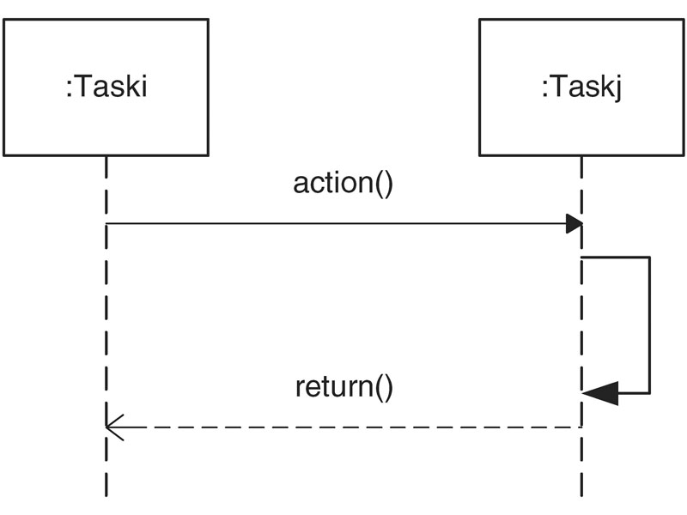
fig_05_08
UML: interaction diagram—call and return
What does this arrow represent?

Slide 27
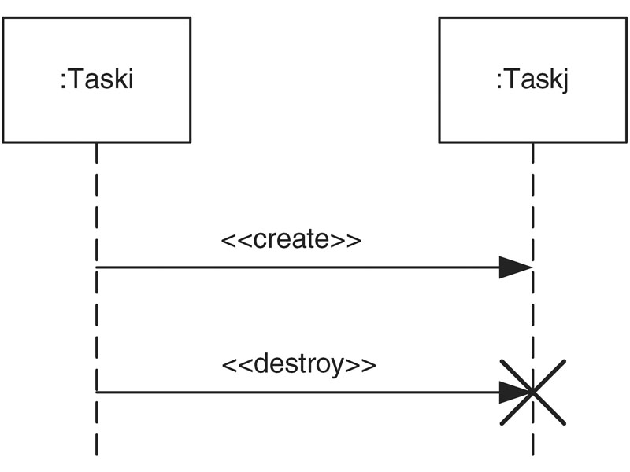
fig_05_09
UML: interaction diagram—create and destroy

Slide 28
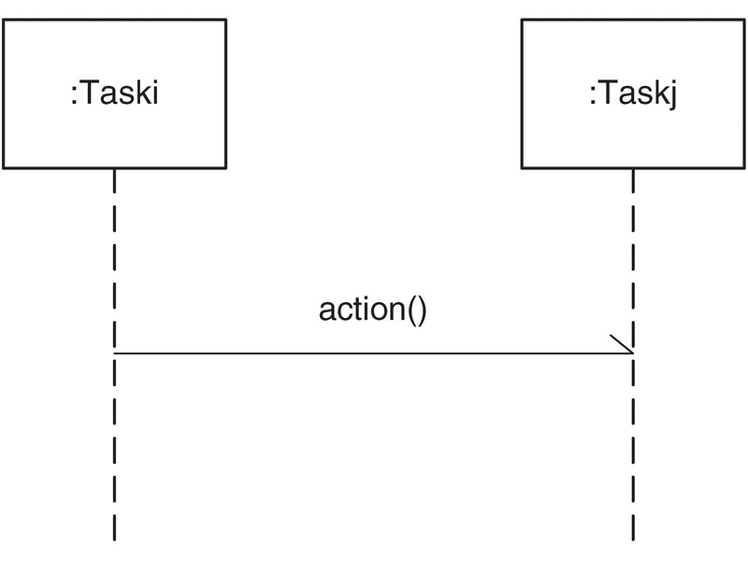
fig_05_10
UML: interaction diagram—send (no response expected)

Slide 29
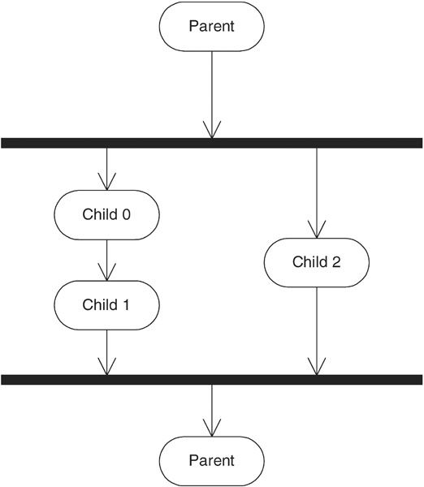
fig_05_13
UML: concurrent behavior.
Example: fork and join
fig_05_13

Slide 30
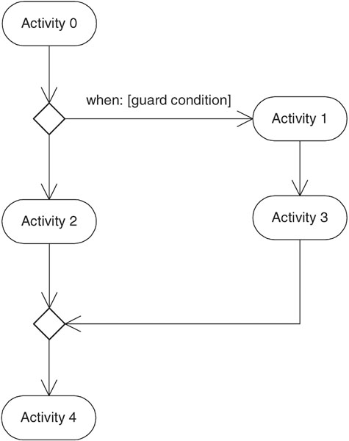
fig_05_14
UML: concurrent behavior.
Example: branch and merge
fig_05_14

Slide 31
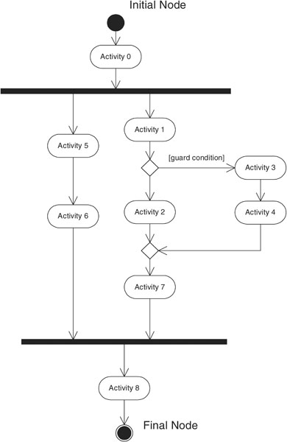
fig_05_15
UML activity diagram—captures all actions and control flows within a task
fig_05_15

Slide 32
UML for embedded systems
How to deal with parallelism?
How to deal with all constraints (e.g., “business” constraints)?
How to deal with hardware / software co-design?
How to deal with timing and real-time constraints?
One answer: annotation (we saw this in camera example, e.g.)

